Slide 1
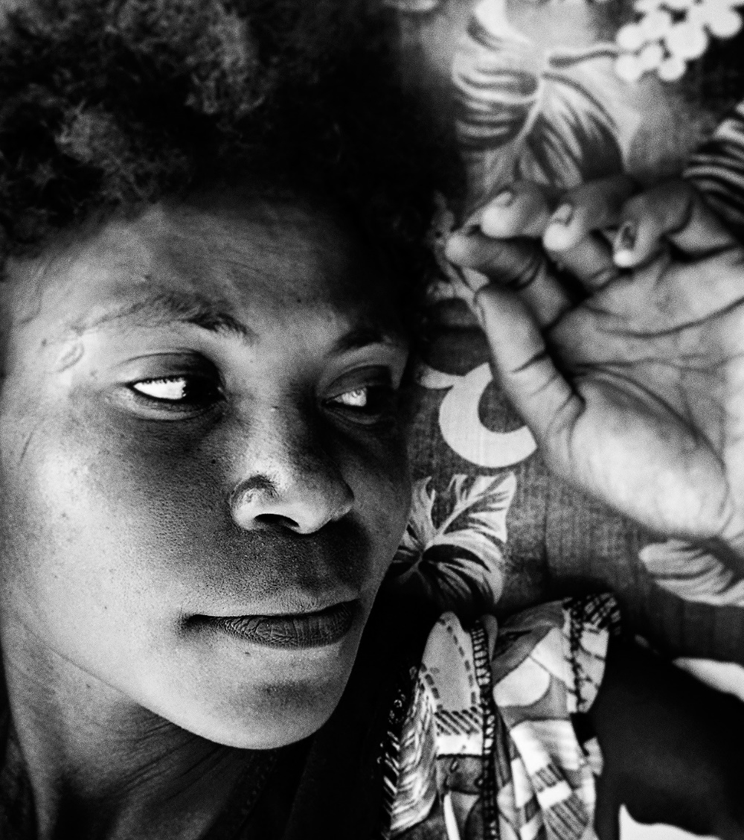
Immediate Postpartum Contraception
Postpartum contraception agenda for Pacific Island countries. Professor Kirsten Black PSRH Family Planning committee
Post partum family planning

Slide 2

Background
Increasing recognition of the
importance of integration of FP into antenatal and postnatal care

Slide 3


Why is postpartum family planning important?

Slide 4
Background
DHS data from 27 countries, show that 95% of women who are 0–12 months postpartum want to avoid a pregnancy in the next 24 months; but 70% of them are not using contraception (Ross & Winfrey 2001).
Ovulation can occur as early as 25 days postpartum
40-57% of women report having unprotected intercourse within the first 6 weeks of delivery
Notes:
Ovulation occurs at a mean of 39 days postpartum in nonlactating women, and can occur as early as 25 days, putting postpartum women at risk of unintended and short-interval pregnancy
According to an analysis of Demographic and Health Surveys data from 27 countries, 95% of women who are 0–12 months postpartum want to avoid a pregnancy in the next 24 months; but 70% of them are not using contraception (Ross & Winfrey 2001).

Slide 5

Risks of a short IPI
MATERNAL RISKS
FETAL RISKS
ECONOMIC RISKS
  Poorer nutritional status
  Placental disorders
  Uterine rupture
  Gestational Diabetes
  Perinatal Depression
  Stillbirth
  Neonatal death
  SGA / Low birth weight
  Pre-term delivery
  Increases consecutive time outside of workforce
  Increases costs for families, and reduces ability for wealth creation
  Cost to Government from unintended pregnancies
Notes:
IPI's of < 6 months are associated with significant foetal risks in higher income settings, whereas < 12 months are associated with worse outcomes in low income settings
There is a body of literature that has documented the association between short IPIs and adverse events. Theories for the increased incidence of adverse outcomes with short IPIs include the maternal depletion hypothesis, in which there is insufficient time for women to re-establish an optimal nutritional state prior to pregnancy; infectious causes; and deficient recovery of uterine scars.13 Women with shorter IPIs are more likely to experience placental abruption, placenta praevia,14 uterine rupture (for women who previously delivered by caesarean section)14,15 and gestational diabetes.16 Neonatal adverse outcomes include an increased risk of stillbirth, small size for gestational age, preterm delivery and neonatal death.17–19
*Most of the literature comes from low income/ resource poor settings
In high-resource settings, there is some evidence showing interpregnancy intervals <6 months since last livebirth are associated with increased risks for preterm birth, small-for-gestational age and infant death
A south american study of almost 1300 women found higher rates of depressive symptoms in patients with a shorter interpregnancy interval

Slide 6
Survey of Postpartum family planning in the Pacific

Slide 7
 | Is routine family planning counselling undertaken in antenatal clinic and integrated into maternity care?
RMI | (✓)
Samoa | (✓)
Kiribati | X
Fiji | ✓
Solomon Islands | X
Vanuatu | X
Micronesia | (✓)
Nauru | X
Tonga | ✓

Slide 8
 | Is PPFP routinely provided before discharge?
 | Implants | IUDs
RMI | ✓ | X
Samoa | (✓) | X
Kiribati | ✓ | X
Fiji | (✓) | X
Solomon Islands | ✓ | X
Vanuatu | (✓) | X
Micronesia | X | X
Nauru | X | X
Tonga | ✓ | X

Slide 9
 | National FP Guidelines | SRH RMNCAH policies?
RMI | No | Draft RMNCAH mentions FP
Samoa | No | SRH policy mentions family planning but no specific mention of PPFP
Kiribati | No | RMNCAH mentions FP and PPFP
Fiji | No | Draft RMNCAH mentions FP
Solomon Islands | No | National Population policy recognises need to improve FP
Vanuatu | No | RMNCAH mentions unmet need for FP
Micronesia | No | No
Nauru | No | Standard treatment guidelines mention FP
Tonga | No | RMNCAH mentions unmet need for FP

Slide 10
 | What are the barriers to PPFP?
RMI | Lack of HCP knowledge and skills
Samoa | Low levels of community knowledge and lack of HCP skills
Kiribati | Low levels of community knowledge, religion and HCP skills
Fiji | Low levels of knowledge amongst midwives and community
Solomon Islands | Low levels of community knowledge, HCP skills
Vanuatu | Low levels of knowledge amongst HCP and community
Micronesia | Low community acceptance of contraception
Nauru | Low community acceptance of contraception
Tonga | Need for community education and HCP skills

Slide 11
 | Is there a need for training in PPFP?
RMI | Yes
Samoa | Yes
Kiribati | Yes
Fiji | Yes
Solomon Islands | Yes
Vanuatu | Yes
Micronesia | Yes
Nauru | Yes
Tonga | Yes

Slide 12
Key findings
PPFP uncommonly provided
Antenatal and postnatal counselling on contraception not consistently provided
Low levels of understanding in community and amongst health professionals
Lack of policies and guidelines on PPFP

Slide 13
Recommendations
      PPFP services should be co-designed with local stakeholders to ensure optimal integration into maternity services, and embedded into existing health system structures
      For sustainability, it is highly recommended that PPFP service provision should be incorporated into the training of existing staff
      Both pre-service and on the job training are essential to maintaining a PPFP service, as is ensuring adequate general staffing levels

Slide 14
recommendations
      4. PPFP counselling should be routinely incorporated into maternity services and be provided at multiple time points during ANC and PNC.
      5. Guidelines for clinicians and information resources for women and their partners are required to ensure high quality PPFP service provision
      6. All these recommendations require that PPFP programs work closely with the Ministry of Health in each of the PICs to ensure clinical, education and policy support

Slide 15

Postpartum contraception implementation program in PICs

Slide 16
steps
Educate health workers in family planning options and counselling (ToT)
Co-design of country level program implementation with Master Trainers
Educate maternity staff on modern contraception insertion (implants and IUD) (ToT)
Develop and distribute appropriate information, education & comm materials

Slide 17
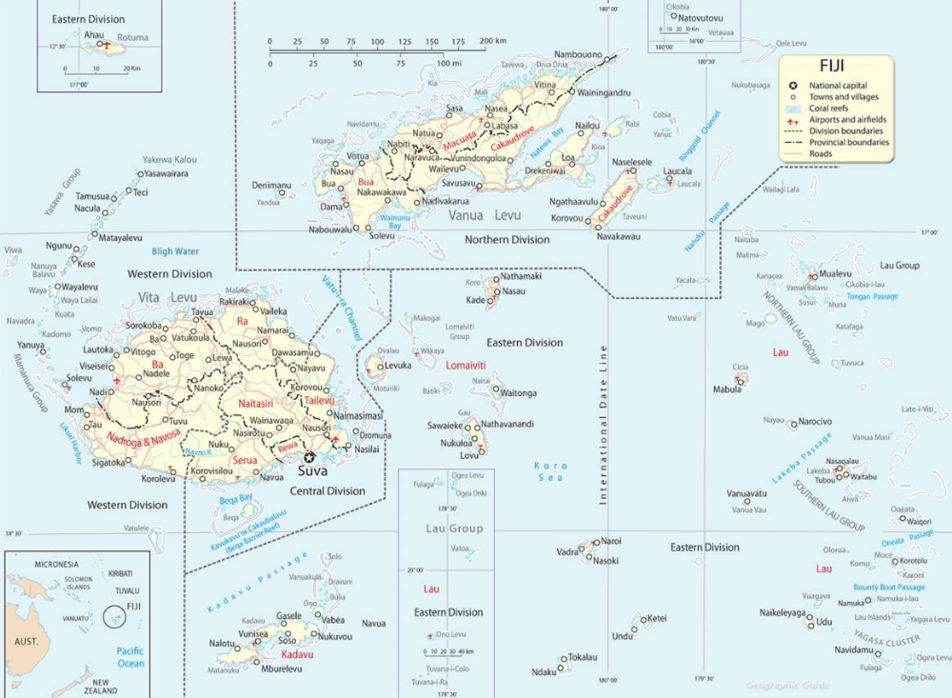
Fiji

Slide 18
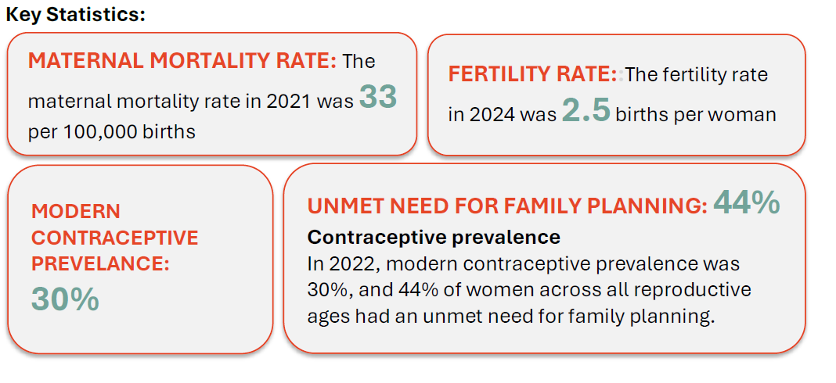

Slide 19
Co-design workshops

Slide 20
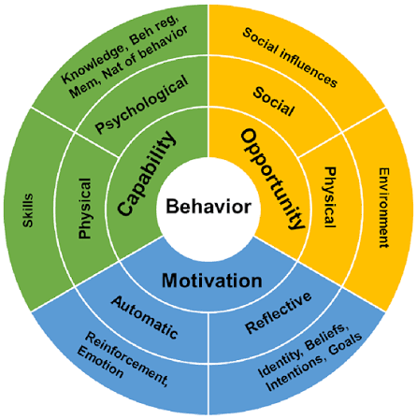
Com-B
Model for behaviour change

Slide 21
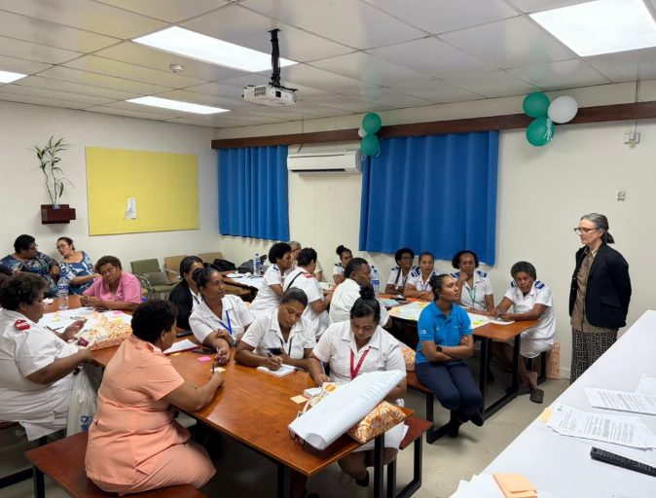
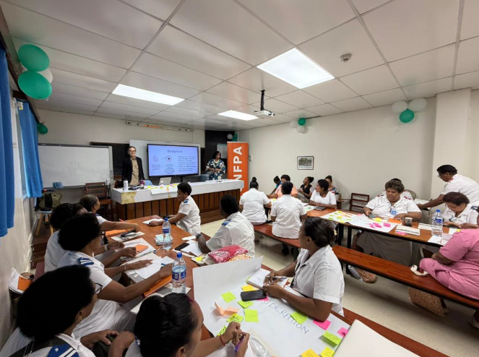
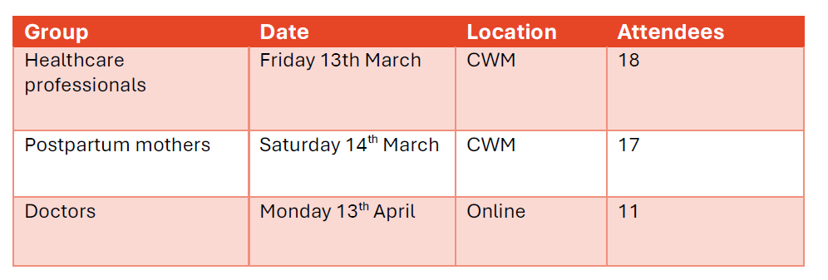

Slide 22
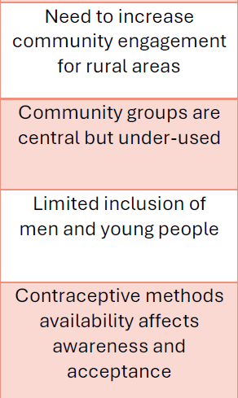
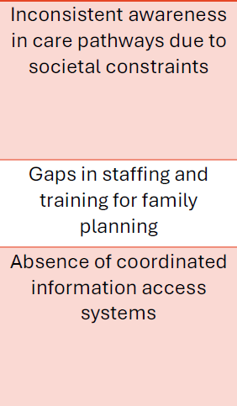
Key themes

Slide 23
Training workshops

Slide 24
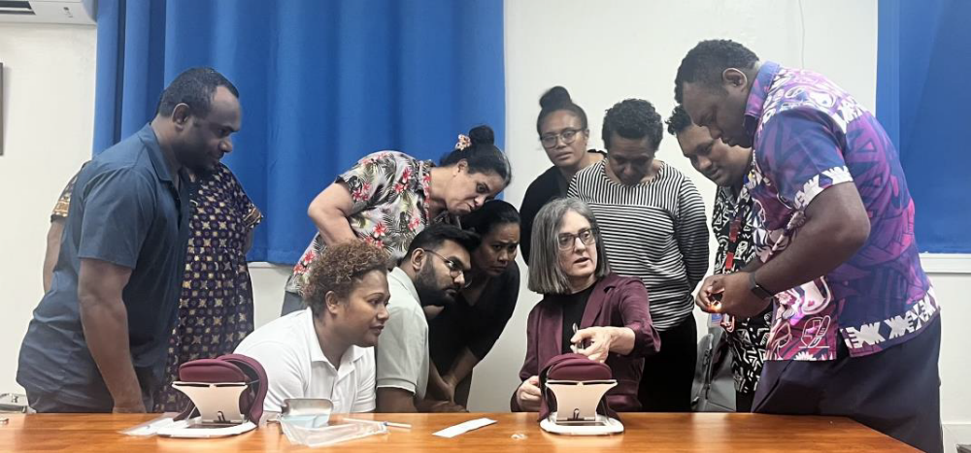
Eastern Division

Slide 25


Western Division

Slide 26

Northern Division

Slide 27
Patient education video

Slide 28

Video

Slide 29

Progress and Evaluation
Integrated into PMOC training at CWM
Pre and post intervention data collection at CWM Hospital with plan to roll out to other centres.
Hope to expand program to other PICs

Slide 30
Looking forward
Seeking funding for policy and guidelines and train the trainer in other PICs
Happy to involve all those who are interested

Slide 31
Thank you

