Slide 1

TOPIC: Barriers and Facilitators to Antenatal Care Access in Savai’i
A Qualitative Study Exploring Maternal Experiences
Presented by:
Ta’ala Logomai Feterika Lualua Tele’a

Slide 2
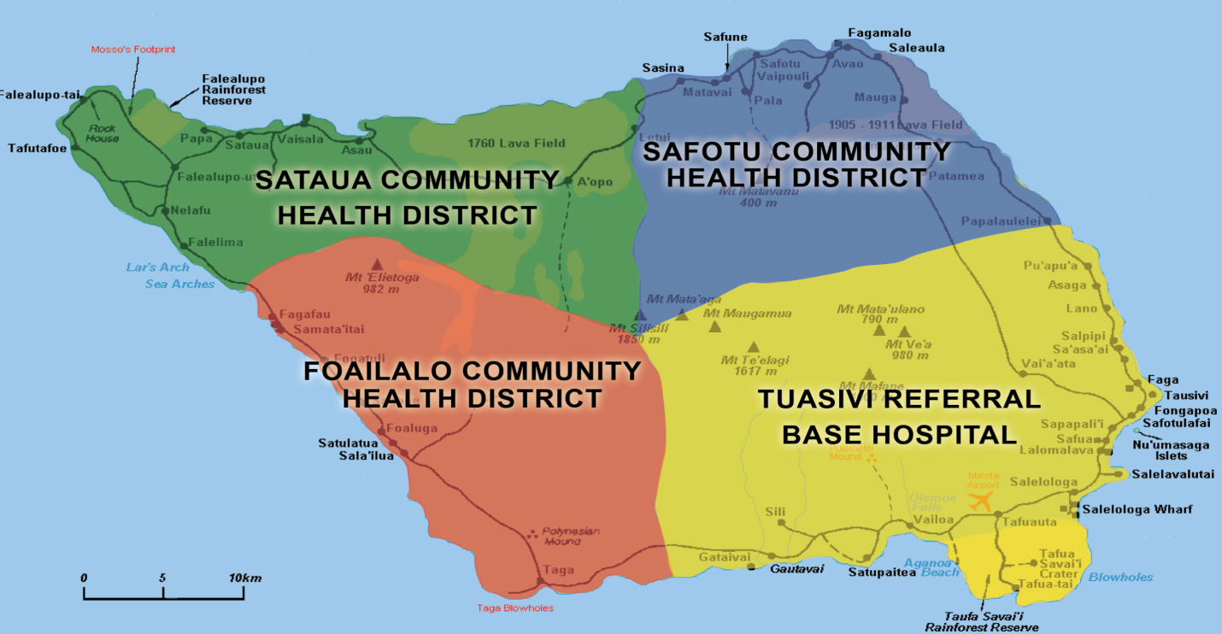

SETTING – Population of 47886.
SAVAI’I ISLAND
In Samoa, women are encouraged to schedule their first antenatal visit as soon as possible (prior 20 weeks of pregnancy). (Samoa Protocol/Guidelines for Management in Pregnancy and Childbirth, 2012).
National Health Services Key Performance Indicator (KPI)
  Measure # 57 - Number of mothers that visit the antenatal clinic for first antenatal assessment within the 20 weeks of gestation across all settings.
KPI Savaii report of the last 12 months (JAN 2018 – JAN 2019) - < 40 %
Complications in Pregnant mothers contributes to the # of Savaii transferred cases to Tupua Tamasese Meaole Hospital (TTMH) every month.
      No obstetrician in Savaii
VAIPOULI HEALTH CENTRE
SAFOTU DISTRICT HOSPITAL
P - 7468
SATAUA DISTRICT HOSPITAL
POPULATION-6954
.
FOAILALO DISTRICT HOSPITAL
P - 7194
MALIETOA TANUMAFILI II HOSPITAL
P - 18255
SATUPAITEA DISTRICT HOSPITAL
P- 8015

Slide 3
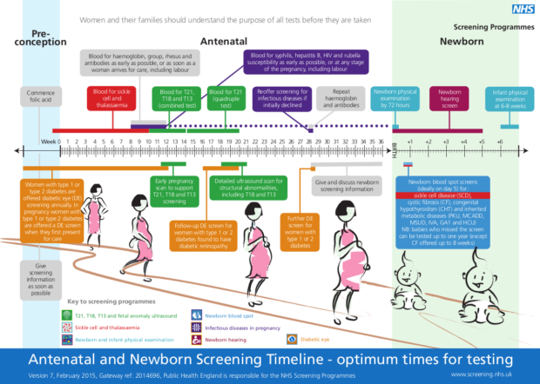
Introduction
SDG 3.1 aims to reduce maternal mortality <70/100,000 by 2030.
Antenatal Care (ANC) ensures the health of both mother and baby.
Detects and manages complications early.
WHO recommends first ANC visit before 12 weeks.

Slide 4
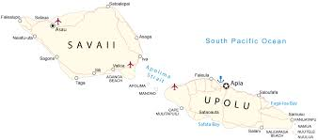
Background
SDHS 2014: 12% booked ANC <12 weeks
SDHS 2019/20: 14.9% booked <12 weeks, 71.5% booked at 4–7 months
Savai‘i ANC booking rate (<20 weeks): under 30%
Challenges:
  No resident obstetrician or surgeon
  Referrals to Tupua Tamasese Meaole Hospital (TTMH)
  High transport costs & staff impact

Slide 5
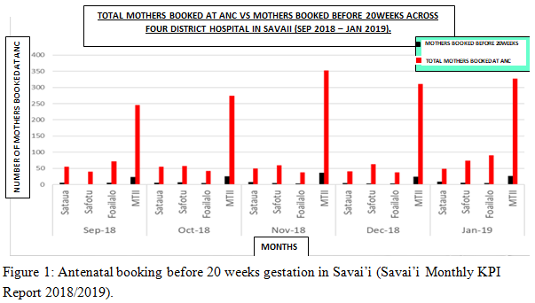

Slide 6
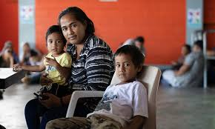
Purpose/Aims:
To explore barriers and facilitators to ANC early engagement.
To inform practical, educational, and policy changes to improve maternal health outcomes.
Research Purpose & Question
Research Question:
What are the views and experiences of women in Savai‘i regarding antenatal care?

Slide 7

Ethical Approval
Approved by:
  VUW Human Ethics Committee (#28457)
  MOH Samoa Ethics Committee
Informed consent obtained from all participants

Slide 8

Methodology
Design: Qualitative Descriptive Study
Participants:
  Pregnant (≥36 weeks) or postnatal (<6 weeks)
  Age 18–49
  3 groups of 6: Early, Late, Unbooked
Data: Semi-structured interviews on knowledge, attitudes, behaviors

Slide 9


Key Findings – Themes Identified
1. Discovery of Pregnancy:
Self or others noticed signs
Emotional reactions:
  Positive: Happy, Excited
  Negative: Fearful, Uncertain
  Mixed: Happy but stressed/shocked
2. Knowledge of Pregnancy:
Awareness of services in Savai‘i
Mismatch between knowledge and behavior
Influence of TBAs and traditional healers

Slide 10
Key Findings – Themes Identified cont’d
3. Barriers:
Limited access (transport, schedule)
Fear of hospital procedures
Knowledge from previous pregnancies
Caregiving roles & early pregnancy symptoms
Cultural beliefs and unfamiliarity with hospitals
4. Facilitators:
Positive clinic experiences
Good understanding of ANC benefits
Desire for pregnancy/gender confirmation
Family support and encouragement

Slide 11

Global vs Local Barriers
Global Issues:
Fear of procedures
Transport challenges
Low knowledge
Local Challenges:
Dependence on TBAs
Cultural influences

Slide 12
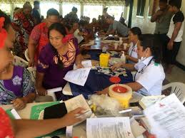
Way Forward
Integrate midwives into communities
Strengthen outreach & transport
Re-engage and train TBAs
Encourage collaboration: TBAs & midwives
Address myths and cultural beliefs

Slide 13
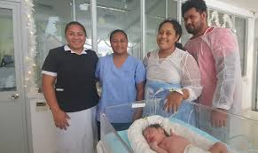
Impacts and Recommendation
  Improved maternal and child health outcomes.
  Empowered communities with better healthcare access.

Slide 14

Challenges in Conducting Study
COVID-19 disruptions
Staff work commitments
Participant availability
Rescheduling & no responses
Transcription & translation delays
Family obligations
Limited funding

Slide 15

Acknowledgements
Grateful to:
  Almighty God
  VUW & GROW OUR OWN
  National University of Samoa
  Ministry of Health
  Supervisor – Assoc. Prof. Robyn Maude
  Participants, families & friends

Slide 16
Fa’afetai tele lava

