Slide 1
GENDER BASED VIOLENCE

Slide 2
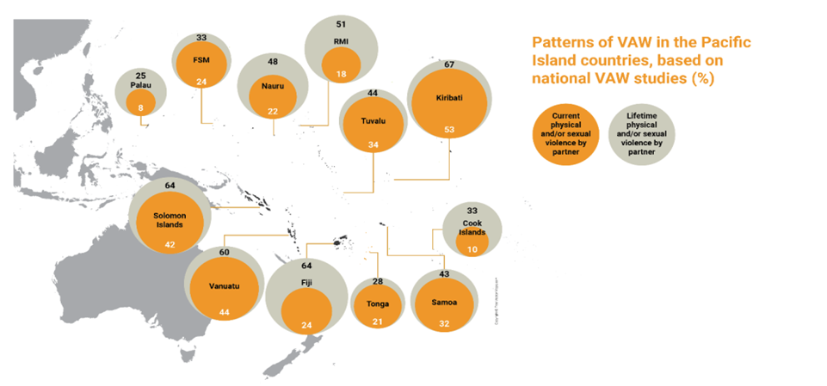
[Patterns of VAW in the PICs ]
30%♀globally have experienced physical &/or sexual violence by their partner
Caring for women subjected to violence: A WHO curriculum for training health-care providers
Session 1: Understanding VAW as a public health problem
Notes:
For the pacific, an average of 66% of women have experienced Intimate partner

Slide 3

Violence starts early in women’s lives
Age group, years | Prevalence, % | 95% CI, %
15 – 19 | 29.4 | 26.8 to 32.1
20 – 24 | 31.6 | 29.2 to 33.9
25 – 29 | 32.3 | 30.0 to 34.6
30 – 34 | 31.1 | 28.9 to 33.4
35 – 39 | 36.6 | 30.0 to 43.2
40 – 44 | 37.8 | 30.7 to 44.9
45 – 49 | 29.2 | 26.9 to 31.5
50 – 54 | 25.5 | 18.6 to 32.4
55 – 69 | 15.1 | 6.1 to 24.1
60 – 64 | 19.6 | 9.6 to 29.5
65 – 59 | 22.2 | 12.8 to 31.6
Lifetime prevalence of partner violence by age
Caring for women subjected to violence: A WHO curriculum for training health-care providers
Session 1: Understanding VAW as a public health problem

Slide 4
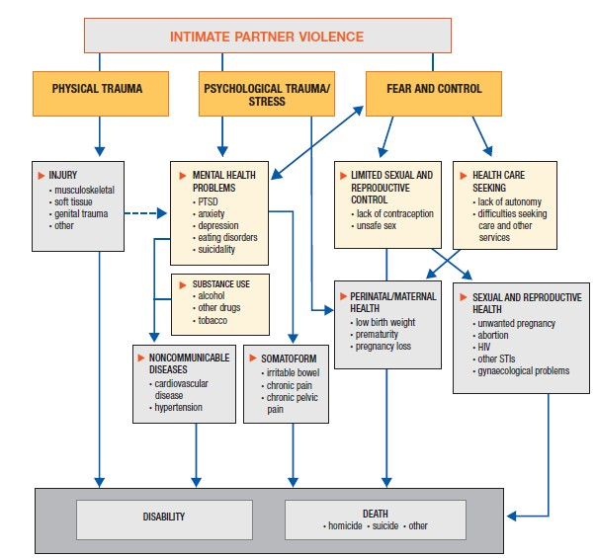
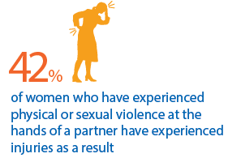
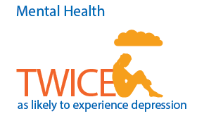
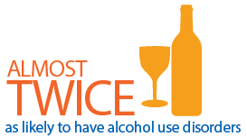
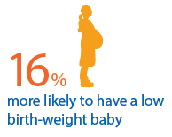
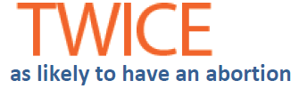
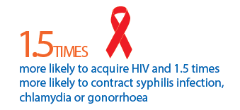

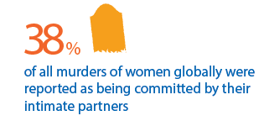
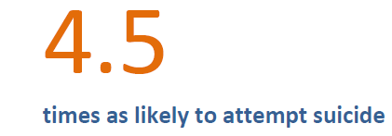
Pathways & health effects
Caring for women subjected to violence: A WHO curriculum for training health-care providers
Session 1: Understanding VAW as a public health problem
14

Slide 5
Inter-generational & socio-economic consequences
Effects on children | Higher rates of infant mortality Behaviour problems Anxiety, depression, attempted suicide Poor school performance Experiencing or perpetrating violence as adults Physical injury or health complaints Lost productivity in adulthood
Effects on families | Inability to work Lost wages and productivity Housing instability
Social and economic effects | Costs of services incurred by victims and families (health, social, justice) Lost workplace productivity and costs to employers Perpetuation of violence
Caring for women subjected to violence: A WHO curriculum for training health-care providers
Session 1: Understanding VAW as a public health problem
15

Slide 6

Health providers and health systems have a critical role in supporting women, minimizing the impact of violence and preventing violence
Why health systems?
Women and girls experiencing violence are more likely to use health services
Health-care providers are often women’s first point of professional contact
All women are likely to seek health services at some point in their lives
Caring for women subjected to violence: A WHO curriculum for training health-care providers
Session 1: Understanding VAW as a public health problem
17
Notes:
Providers are often seen as role models in the community and are trusted by
women

Slide 7
Evidence have showed that women do not mind being asked about the abuse provided it is done in a sensitive manner.
Speaking in the right way provides validation for the patient and help her realize that help is available. It is a powerful first step in seeking help
We can never be certain of patients behavior after they leave or control what they do and may take multiple interventions. However conversations with providers is an important starting point.

Slide 8
Providers are NOT responsible for
Solving violence-related issues
Addressing all violence-related needs
Addressing all aspects of treatment, care & support in one consultation
Caring for women subjected to violence: A WHO curriculum for training health-care providers
Session 1: Understanding VAW as a public health problem
20
Notes:
Or making decisions for the woman

Slide 9

Ignoring violence can do harm
Provider behaviour
Blames or disrespects women or girls
Doesn’t recognize VAW behind chronic or recurring conditions
Fails to provide post-rape care or address VAW in FP, STI/HIV care
Breaches privacy or confidentiality
Ignores signs of fear or emotional distress
Possible consequences
Inflicts additional emotional distress or trauma
Woman receives inappropriate or inadequate medical care
Unwanted pregnancy, STIs, HIV, unsafe abortion, more violence
Partner or family member becomes violent after overhearing information
Woman is later injured, killed or commits suicide
Caring for women subjected to violence: A WHO curriculum for training health-care providers
Session 1: Understanding VAW as a public health problem
21
Notes:
Have participants read out each one

Slide 10
It is important for us to be aware of our own beliefs and attitudes, especially if they might harm survivors
If we are aware of our negative beliefs, we can better avoid communicating them to survivors of violence
Changing mindsets takes time, but it can be done. Self-reflection is healthy.
Caring for women subjected to violence: A WHO curriculum for training health-care providers
Session 2: Understanding the survivor’s experience and how providers’ values and beliefs affect the care they give

Slide 11
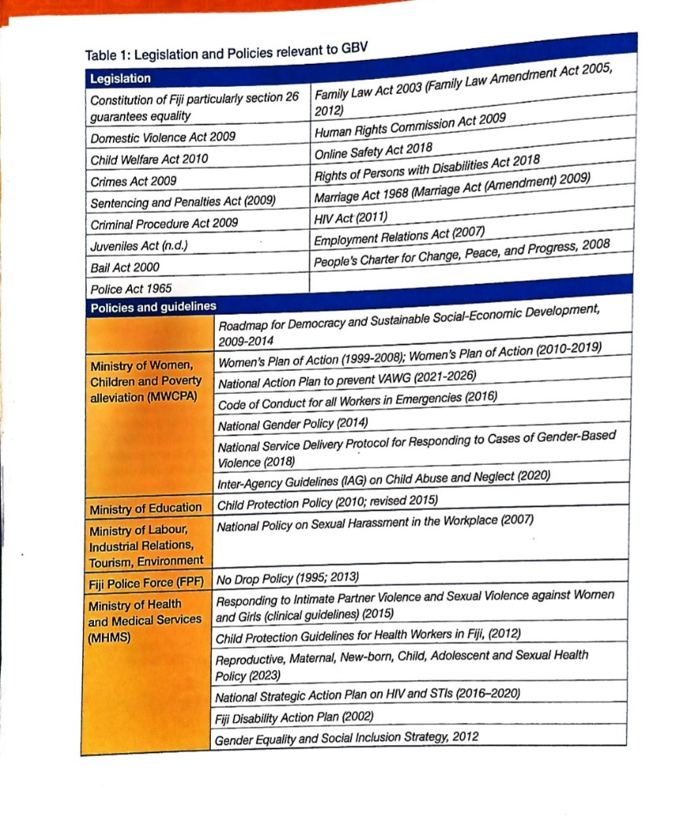
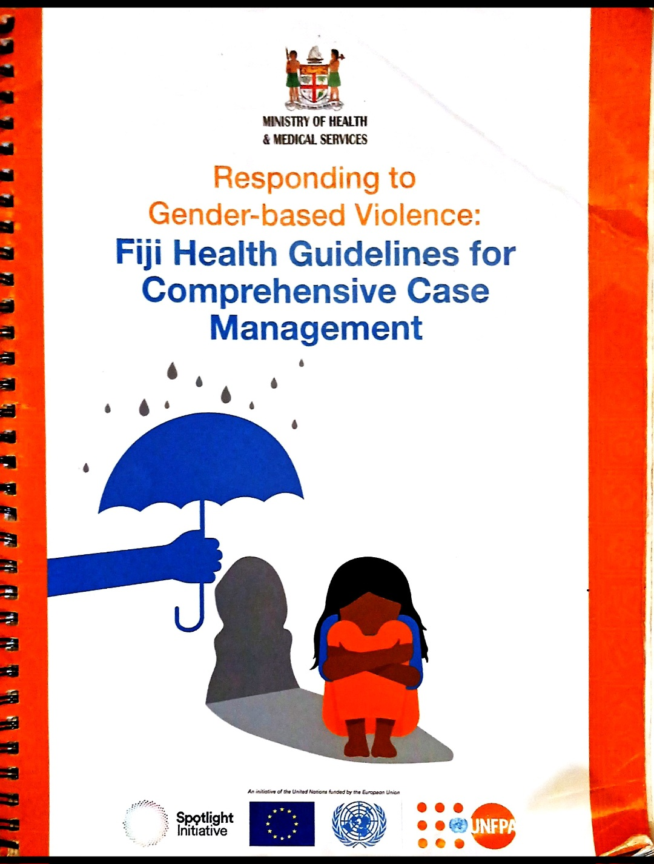
FIJIS RESPONSE TO GBV

Slide 12
